Slide 1
Digital Portfolio
STUDENT NAME: D.Jeslin
REGISTER NO AND NMID: 24CA138
DEPARTMENT: BCA(Computer Application)
COLLEGE: DRBCCC HINDU COLLEGE

Slide 2
PROJECT TITLE
Title: Personal Portfolio Website
using HTML, CSS, and JavaScript
Presented by: D. Jeslin

Slide 3


AGENDA
Problem Statement
Project Overview
End Users
Tools and Technologies
Portfolio design and Layout
Features and Functionality
Results and Screenshots
Conclusion
Github Link
3/21/2024 Annual Review

Slide 4

PROBLEM STATEMENT In the digital era, resumes alone are insufficient to showcase one’s skills, creativity, and projects. Students and beginners often lack a structured way to demonstrate their abilities to recruiters and peers. A portfolio website provides an interactive and professional platform to present technical skills, academic projects, and personal achievements.

Slide 5

PROJECT OVERVIEW The project is a personal portfolio website developed using HTML, CSS, and JavaScript. It contains key sections such as About Me, Skills, Projects, and Contact. Interactive features such as a dropdown menu and modal popups are included to enhance user experience. The design emphasizes simplicity, responsiveness, and professional presentation.

Slide 6
WHO ARE THE END USERS? 1. College Students Primary users who want to showcase their learning journey and projects. Can use the portfolio to demonstrate technical skills, creativity, and problem-solving abilities to faculty, peers, and recruiters. Helps them stand out in academic evaluations, hackathons, and internship applications. 2. Job Seekers / Fresh Graduates Use the portfolio as a professional digital resume during internships and entry-level job applications. Allows them to present projects, skills, and achievements interactively, which is more effective than traditional resumes. 3. Recruiters and Employers Evaluate the candidate’s technical competence, design sense, and coding skills quickly.Interactive portfolios provide quick access to projects, skills, and achievements, making recruitment efficient.

Slide 7

TOOLS AND TECHNIQUES Development Tools: Visual Studio Code (IDE). Web Browser (Google Chrome, Microsoft Edge) Technologies Used: HTML – For webpage structure. CSS – For styling, layout, and design JAVASCRIPT – For interactivity (dropdowns, modal popups)

Slide 8
POTFOLIO DESIGN AND LAYOUT
Header Section: Name, tagline, and three-dots interactive menu.
Navigation Bar: Links to all key sections.
About Section: Brief introduction and career goals.
Skills Section: List of technical skills and learning areas.
Projects Section: Project cards highlighting completed work.
Contact Section: Simple form for user interaction.
Footer: Copyright and closing statement.
Modals: Popups displaying Skills, Journey, and Hobbies.
8

Slide 9
FEATURES AND FUNCTIONALITY Responsive design compatible with both desktop and mobile. Animated dropdown menu for quick navigation. Modal popups to display additional information. Hover effects on project cards for interactivity. Contact form for professional communication. Organized layout for easy readability and navigation.

Slide 10

RESULTS AND SCREENSHOTS Gained experience in designing interactive and responsive layouts. Developed a professional platform to showcase personal skills and projects.
This portfolio result displays my achievements in coding, web design, and projects, along with a simple contact section to connect with me.
3/21/2024 Annual Review
10

Slide 11
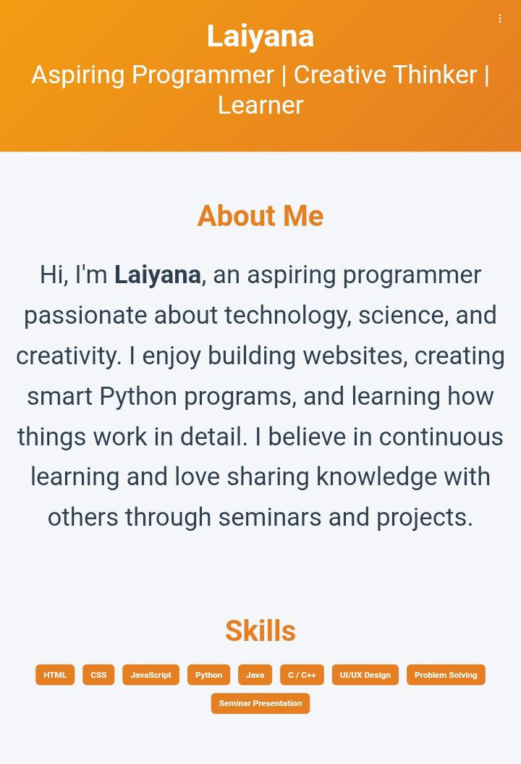
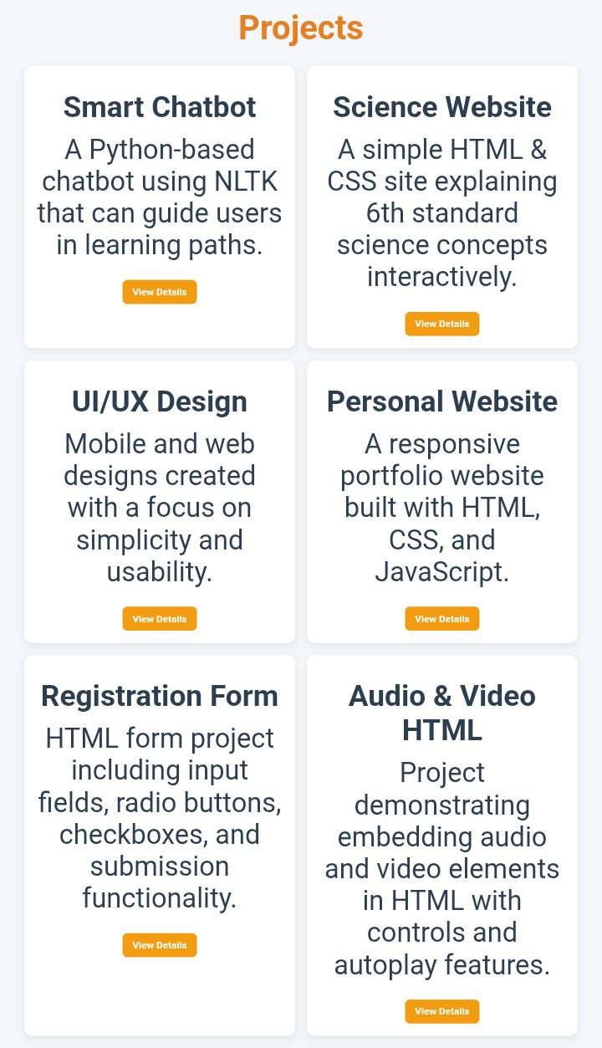
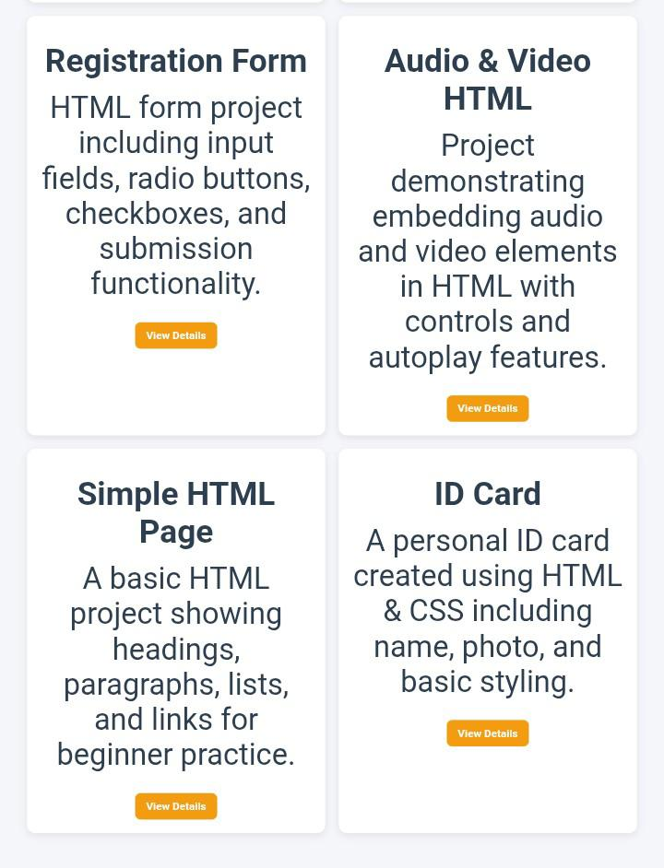
Screenshots My portfolio website: a unique blend of creativity, skills, and self-expression. Showcasing my personal brand through a modern and interactive portfolio output.

Slide 12
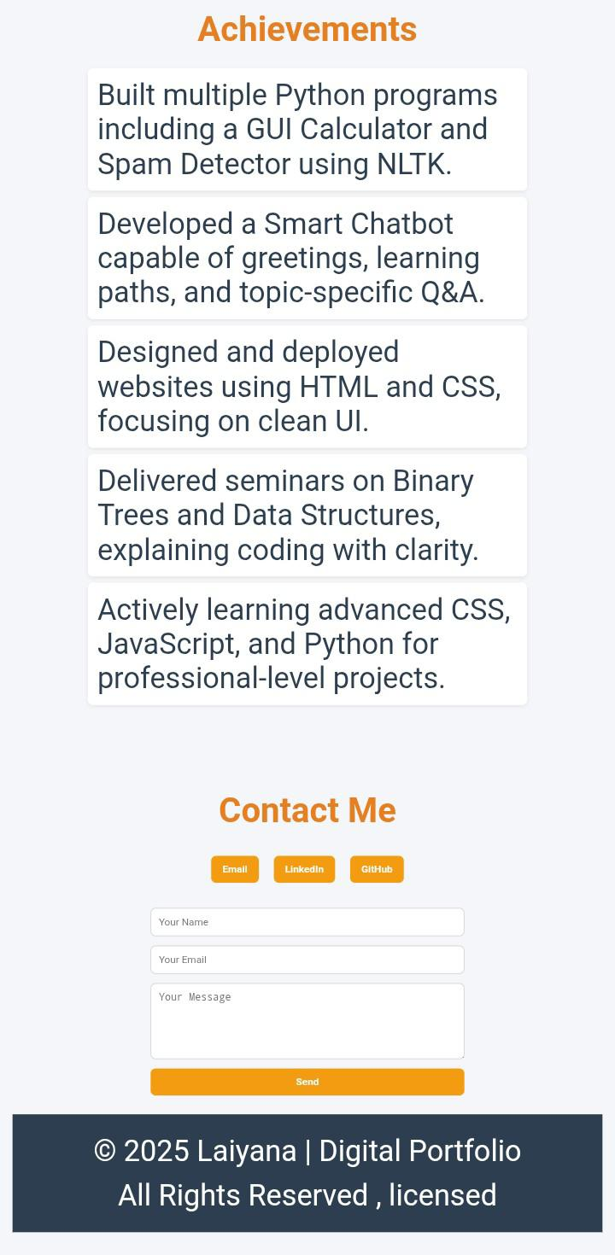
Final screenshots of portfolio
A creative digital portfolio reflecting my journey, skills, and innovations.

Slide 13
CONCLUSION The portfolio project provided practical experience in front-end web development. It demonstrated how a personal website can effectively highlight skills and achievements. This project is a strong step towards building a professional digital presence. Future Enhancements: Add dark/light theme switching. Include animated transitions and effects. Connect the contact form with a backend for real-time communication.
13

